Slide 1
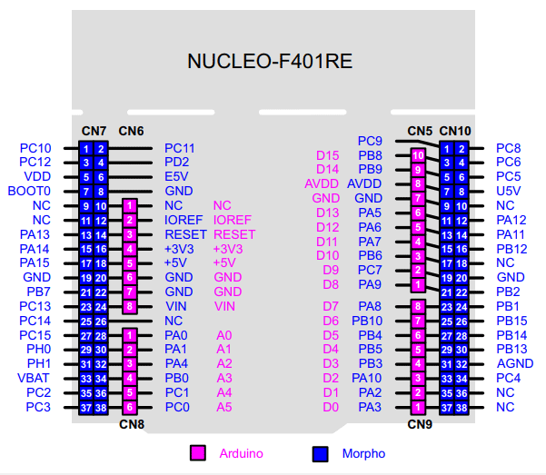

RS
GND
+5V
POT
RS
GND
E
GNDq
GND
GND
GND
D4
D5
D6
D7
NC
NC
E
ld2
D4/5/6/7
leds
button
button

